Slide 1

InsurePlus: Smart Health Insurance Management System
A comprehensive, scalable solution for modern health insurance management built with microservices architecture and modular frontend design

Slide 2

PROJECT OVERVIEW
Transforming Health Insurance Management
What is InsurePlus?
Key Objectives
InsurePlus is an enterprise-grade health insurance management platform designed to streamline operations for administrators, agents, customers, claim officers, and hospitals. Built on modern architectural principles, it delivers seamless experiences across all user roles.
Enable efficient policy and plan management
Streamline claim processing workflows
Facilitate hospital network integration
Provide secure, role-based access control
Deliver real-time notifications and updates

Slide 3





SYSTEM ARCHITECTURE
High-Level Architecture Overview
Client Side
Server Side
Data Layer
Angular-based frontend with modular architecture: Core Module (services), Feature Module (role-specific components), and Shared Module (common UI elements)
Eight Spring Boot microservices orchestrated through API Gateway and Eureka Server for service discovery, with OpenFeign for inter-service communication
Multiple MySQL databases providing data isolation and optimised storage for authentication, hospitals, claims, payments, and plan-policy management

Slide 4
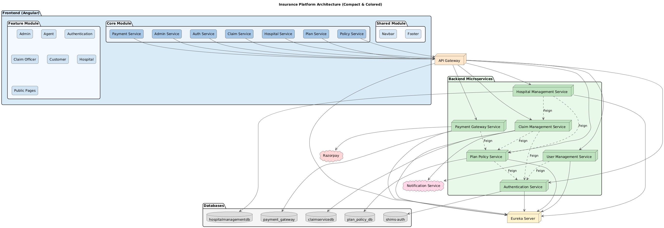
Architecture Diagram Of InsurePlus

Slide 5
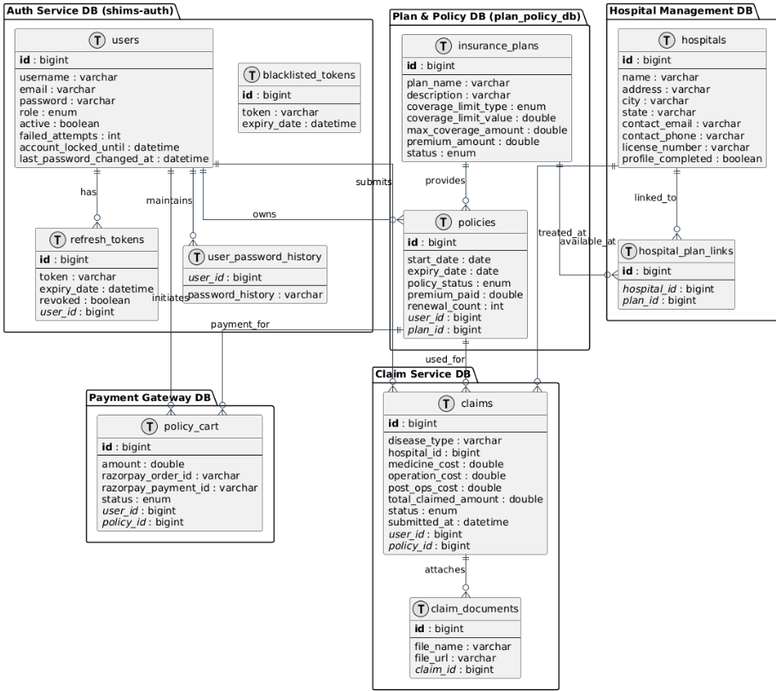
ER DIAGRAM

Slide 6





Standout Features That Set Us Apart
Role-Based Access Control (RBAC)
Lazy Loading Implementation
SMTP Gmail Notifications
Granular permissions ensuring users access only authorised features based on their roles—Admin, Agent, Customer, Claim Officer, or Hospital staff.
Feature modules load on-demand, dramatically reducing initial bundle size and improving application startup performance across all devices.
Real-time email alerts for critical events including payout confirmations, profile updates, and claim status changes, keeping all stakeholders informed.
Robust Security Measures
Razorpay Integration
Multi-layered security with password hashing, JWT tokens, HTTPS encryption, and regular security audits protecting sensitive insurance data.
Seamless payment processing with India's leading payment gateway, supporting multiple payment methods including cards, UPI, and net banking.

Slide 7



AUTHENTICATION & SECURITY
JWT Authentication Flow
User Login
Secure Requests
User submits credentials through Angular frontend to Authentication Service
Access token included in request headers for API Gateway validation before routing
1
2
3
4
Token Generation
Token Refresh
Service validates credentials and generates JWT access token (15 min) and refresh token (7 days)
Expired access tokens automatically refreshed using valid refresh token without re-login
Security Benefits: JWT tokens are stateless, reducing server load whilst providing secure, scalable authentication. Refresh tokens minimise frequent logins whilst maintaining security through short-lived access tokens.

Slide 8
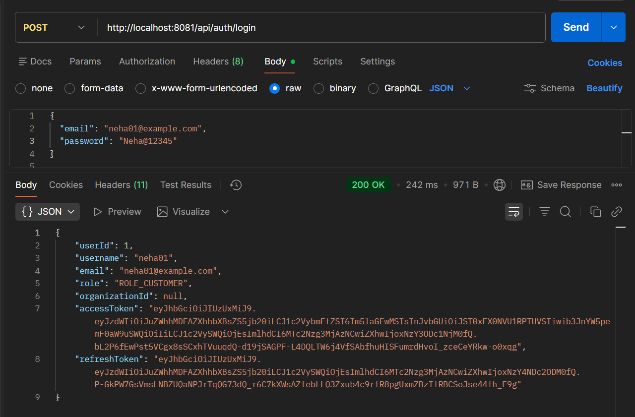
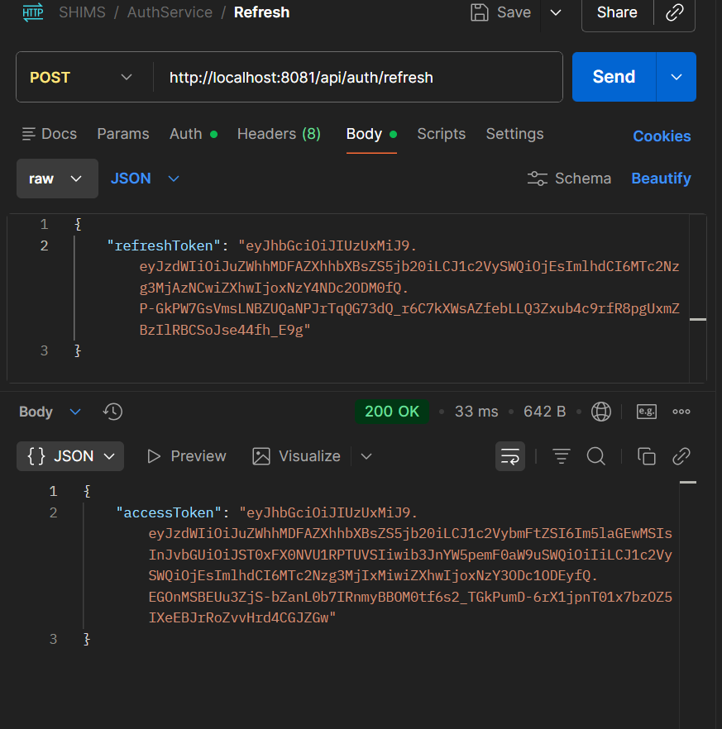
POSTMAN

Slide 9

VALIDATION FRAMEWORK
Robust Multi-Layer Validation System Rremoved
Client-Side Validation
Angular reactive forms with real-time validation feedback for hospital details, plan configurations, policy rules, and claim information. Prevents invalid data submission and enhances user experience with immediate error messages.
Server-Side Validation
Spring Boot validators using Bean Validation (JSR-380) annotations ensure data integrity at the API level. Custom validators enforce business rules such as plan-hospital associations and claim eligibility criteria.
Real-Time Notifications
SMTP-powered email notifications provide instant feedback on validation outcomes, successful operations, and system alerts. Users receive timely updates on claim processing, payment confirmations, and profile changes.
Custom Business Rules
Sophisticated validation logic for hospital detail forms, plan-policy relationships, and claim processing workflows. Rules ensure hospitals are properly linked to plans, claims reference valid policies, and all business constraints are enforced.

Slide 10
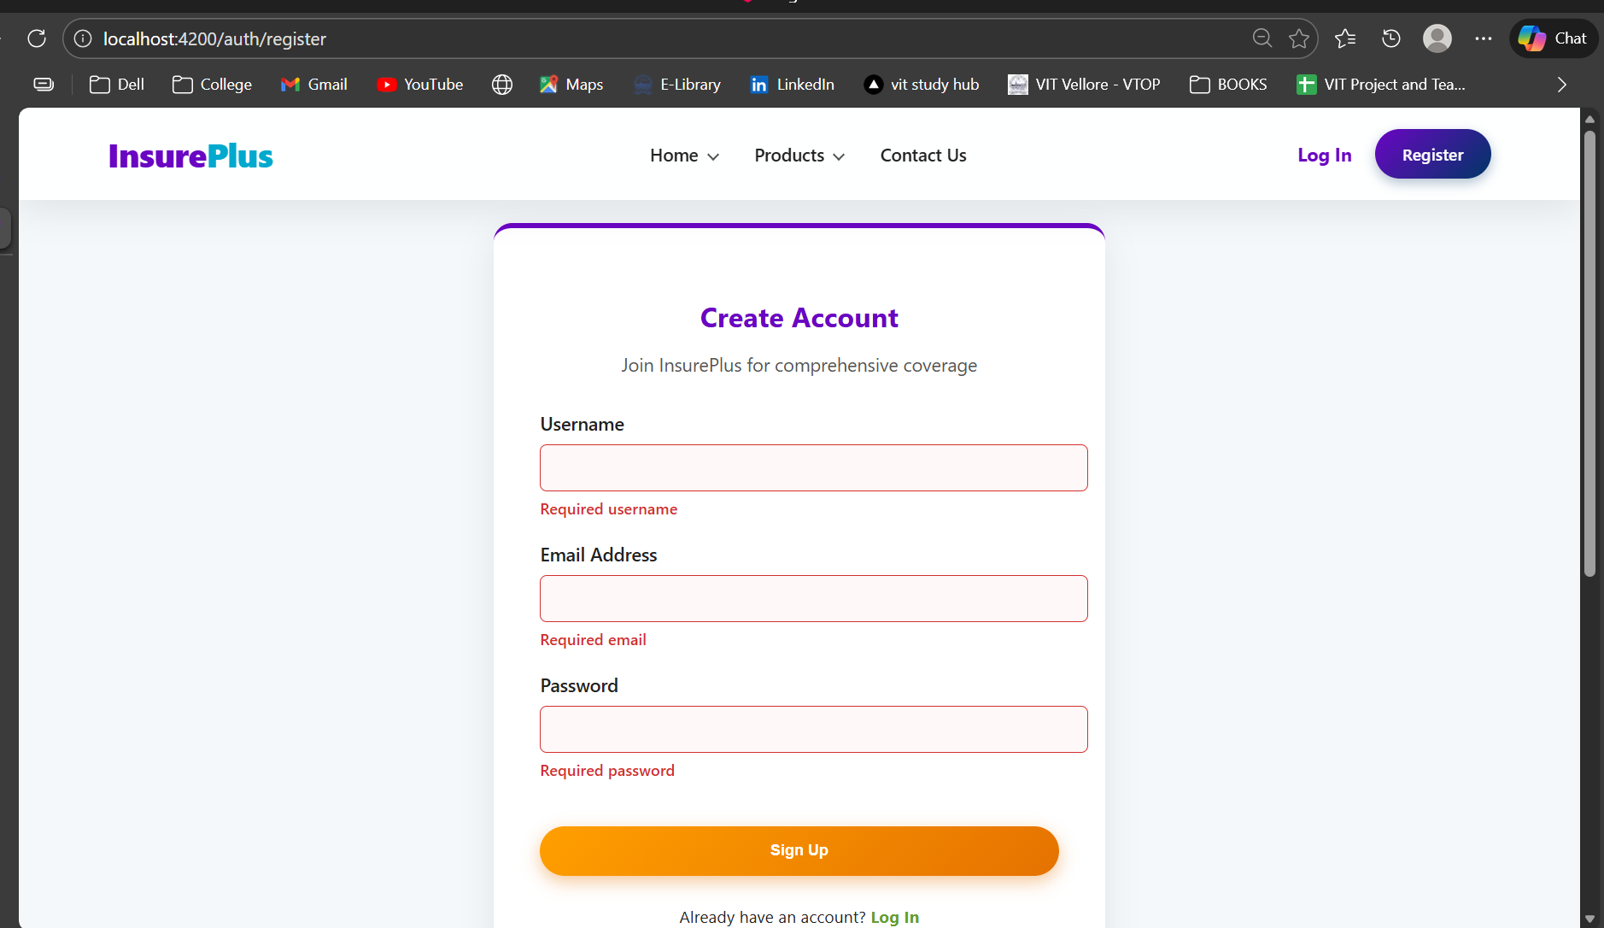
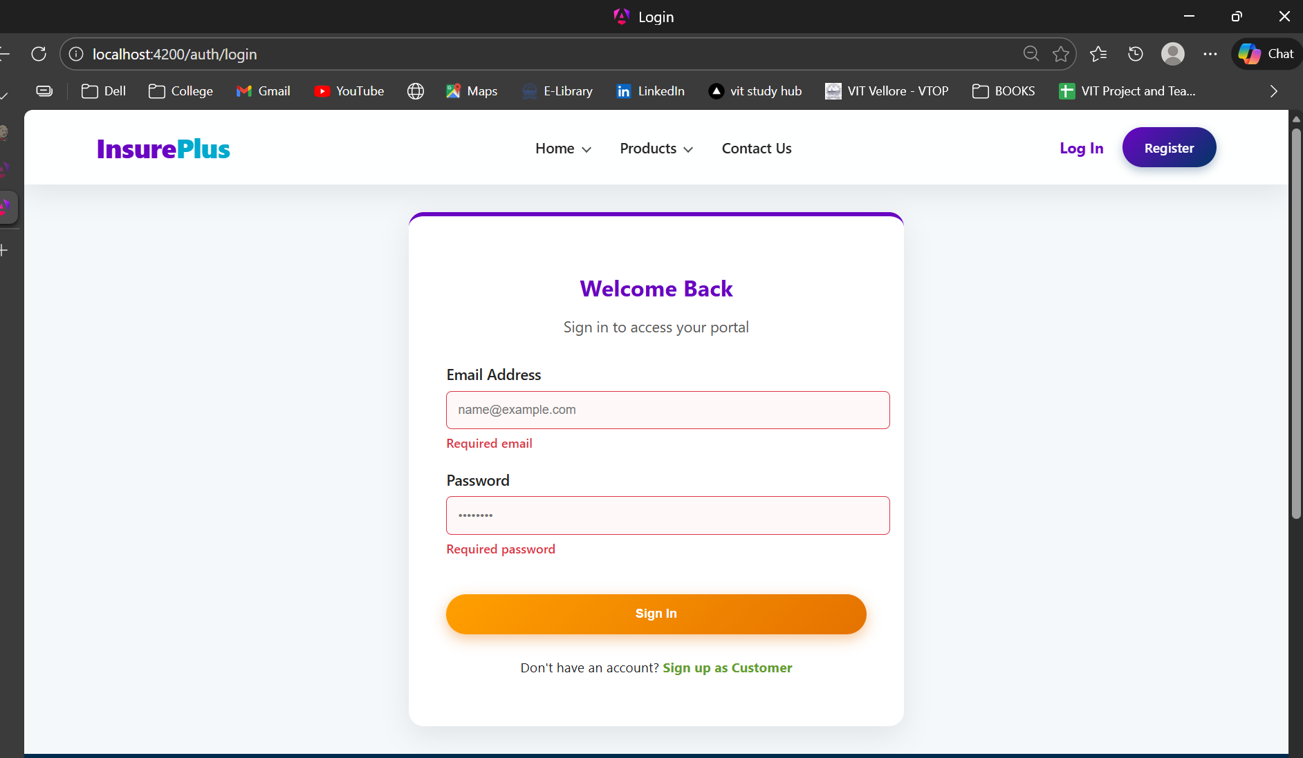

Slide 11
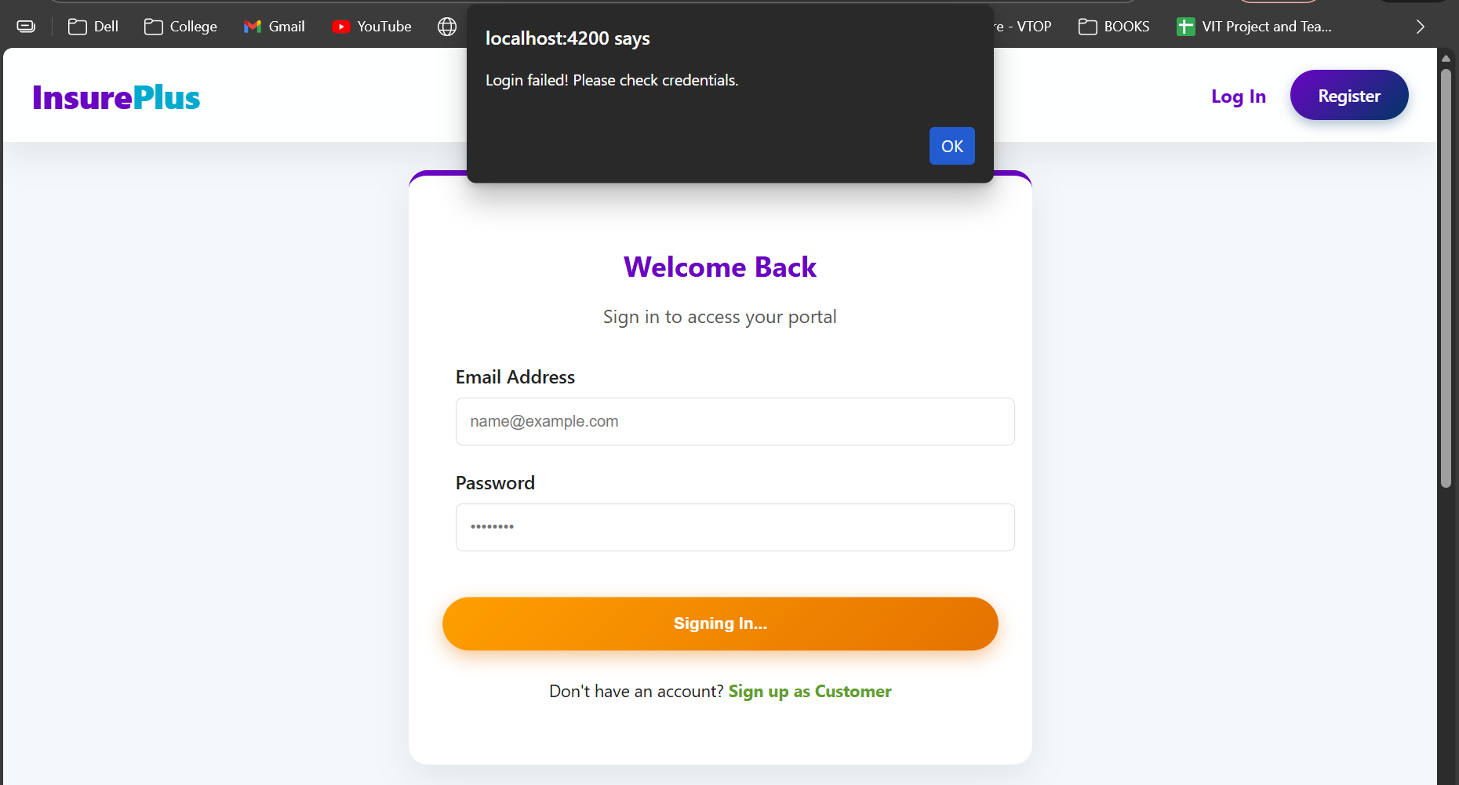
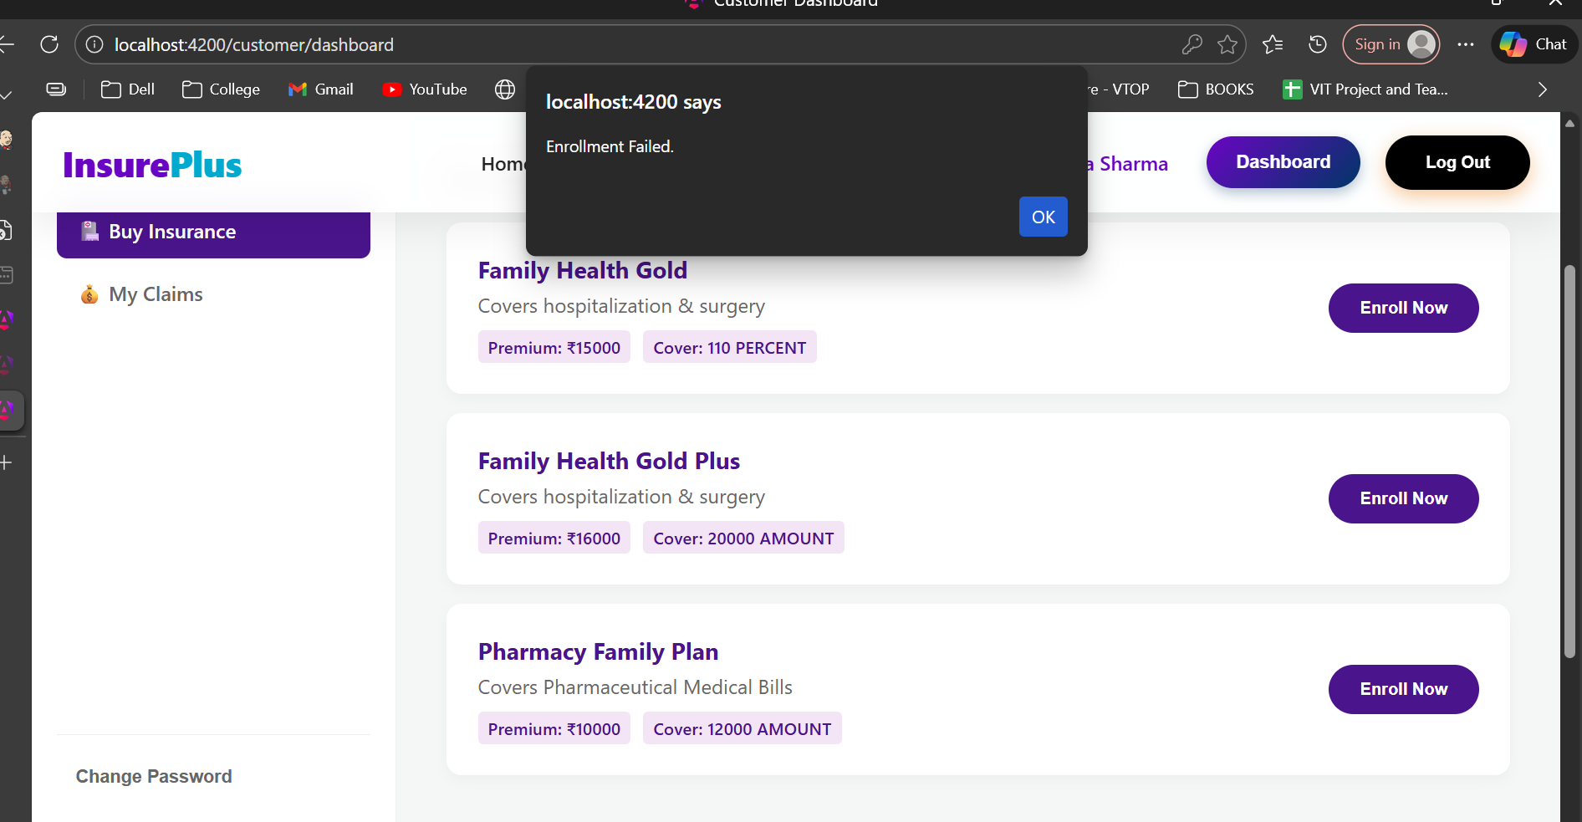

Slide 12
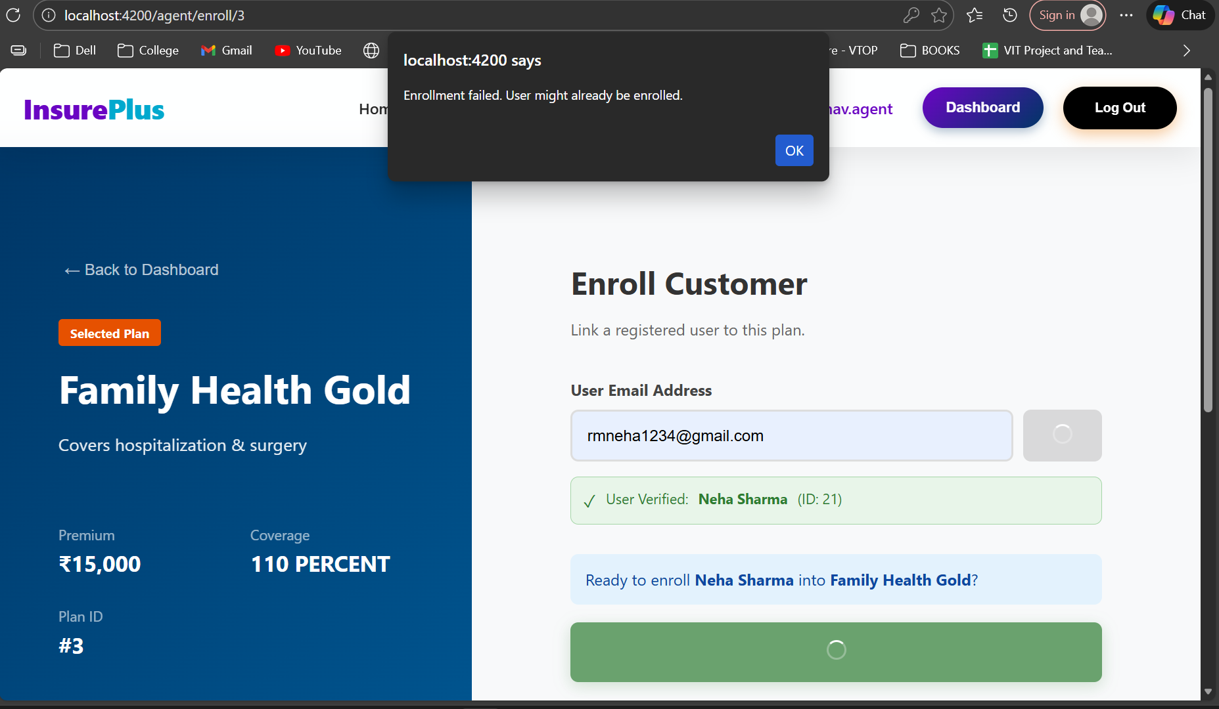
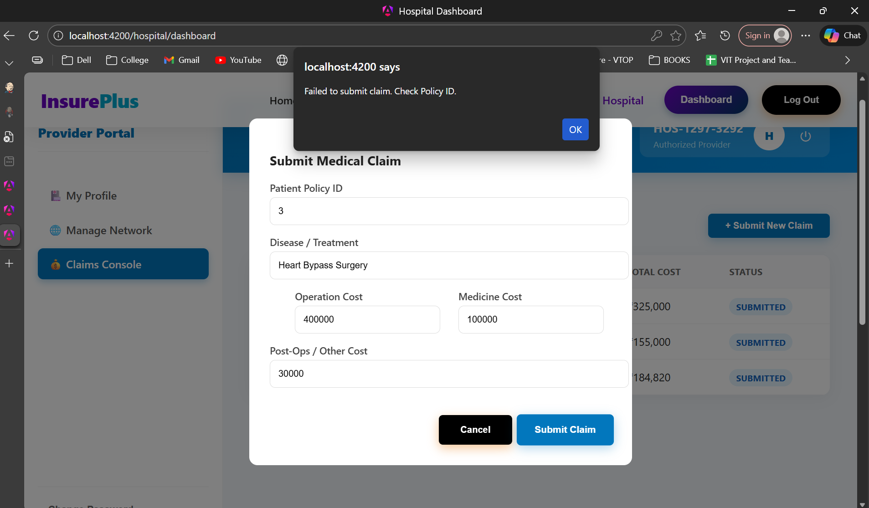

Slide 13
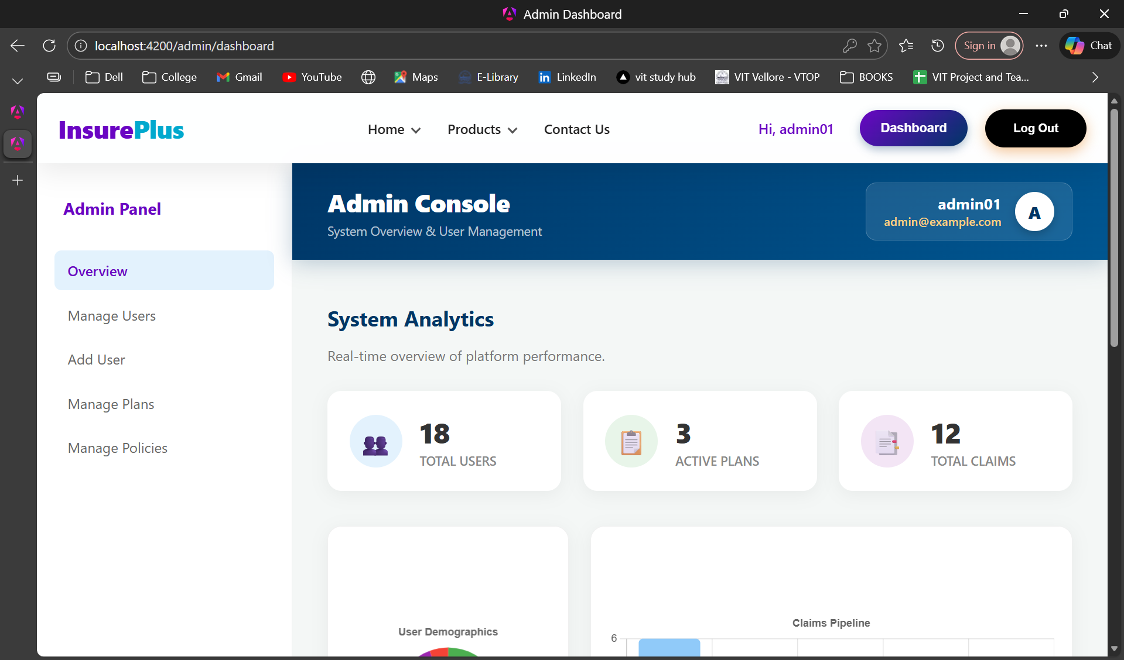

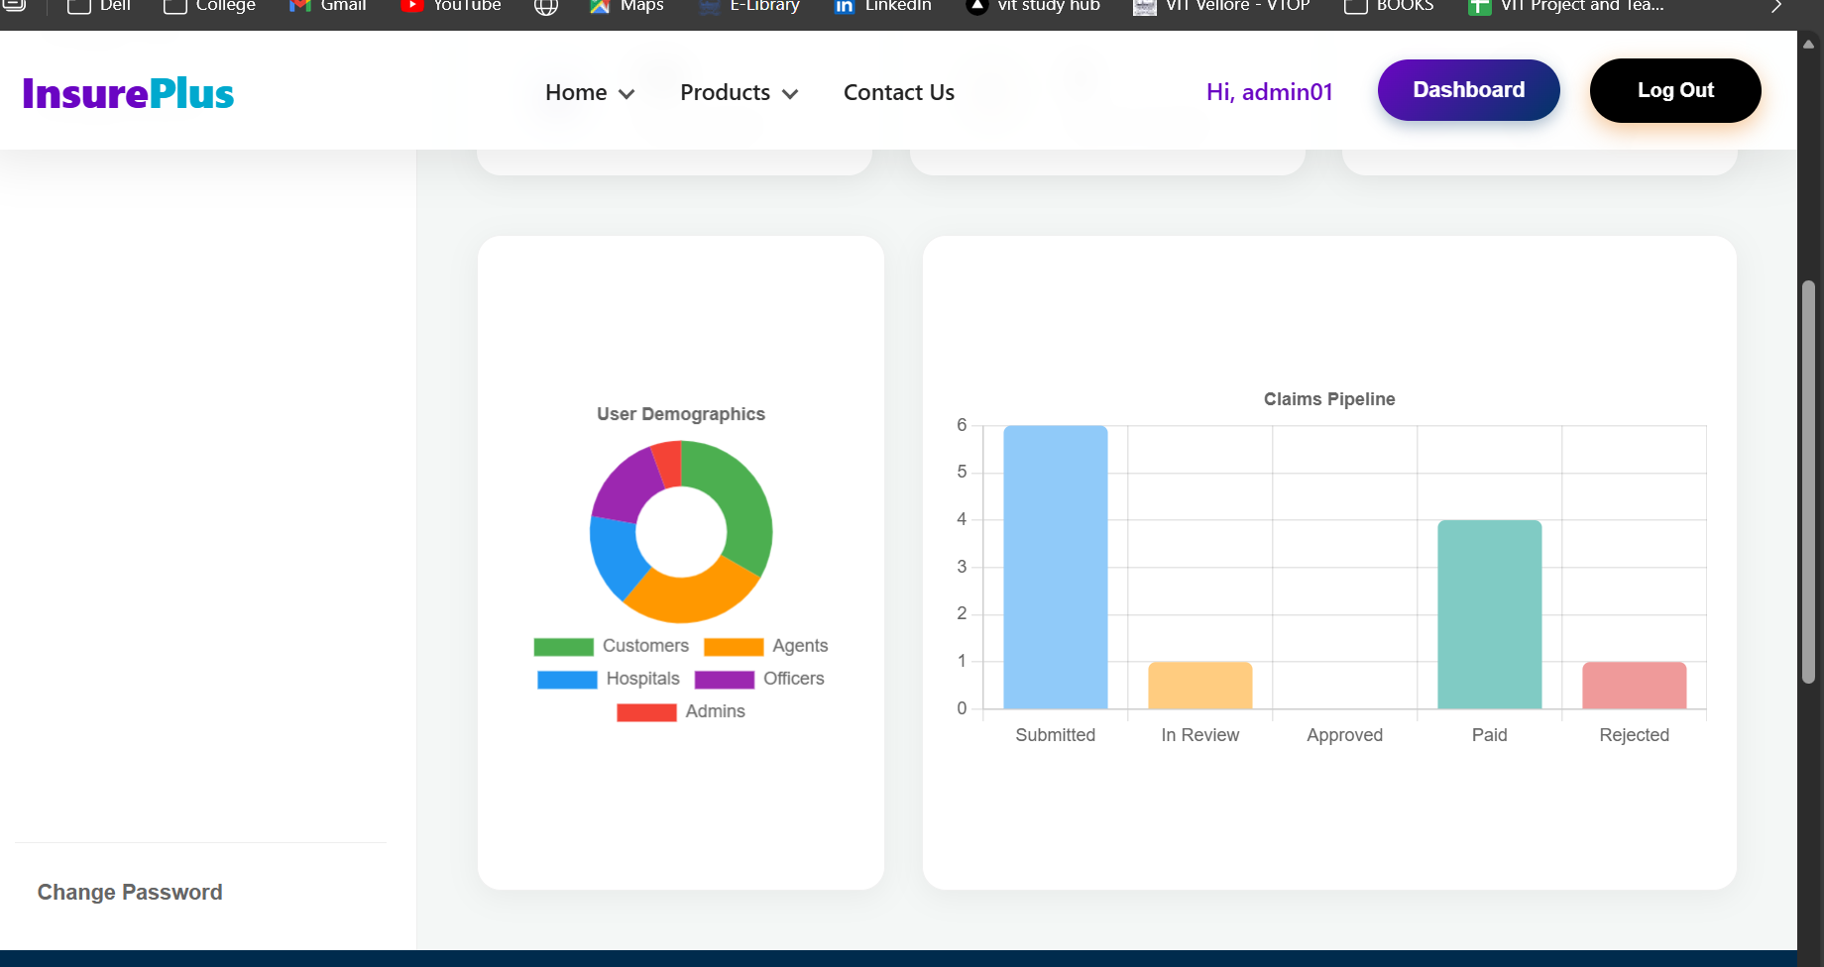
ADMINISTRATION
Centralised Admin Dashboard

Slide 14

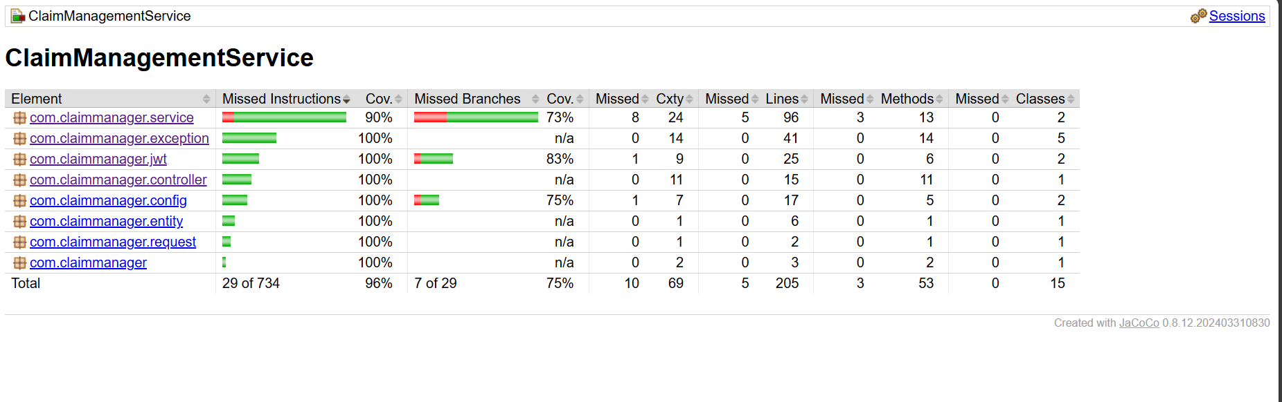
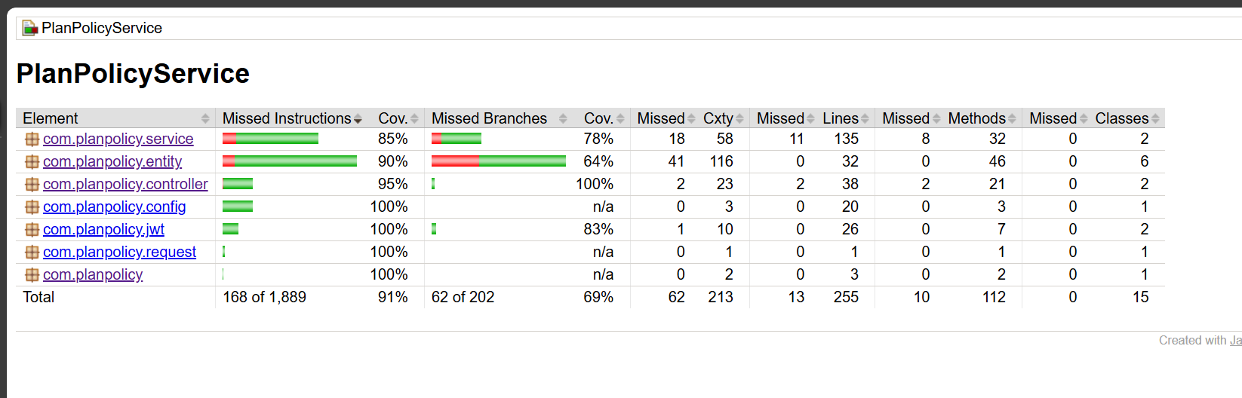
QUALITY ASSURANCE
Ensuring Code Quality Through Comprehensive Testing
Using JaCoCo Reporting

Slide 15
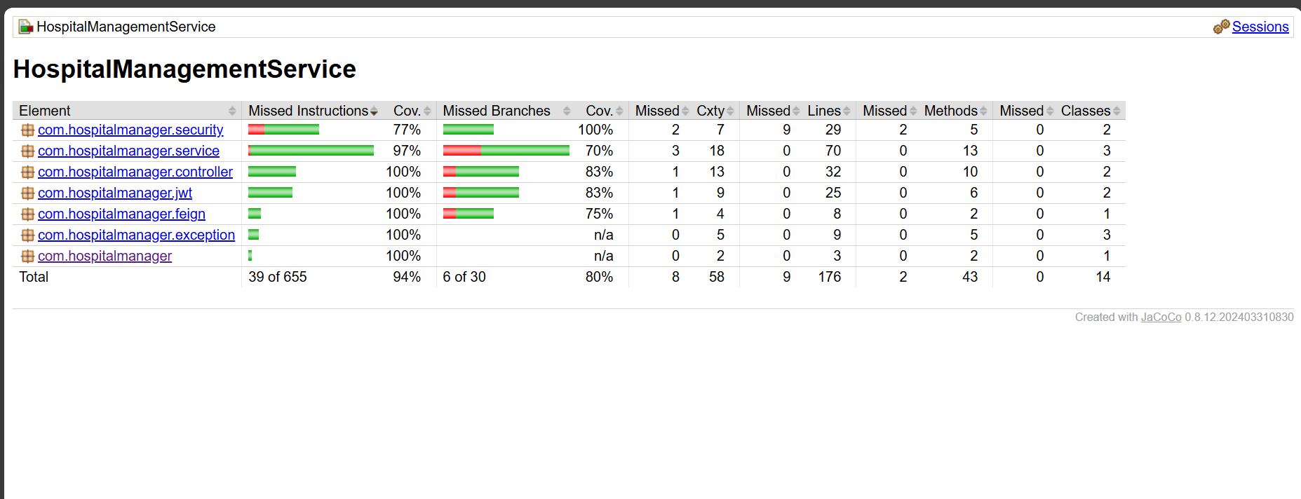
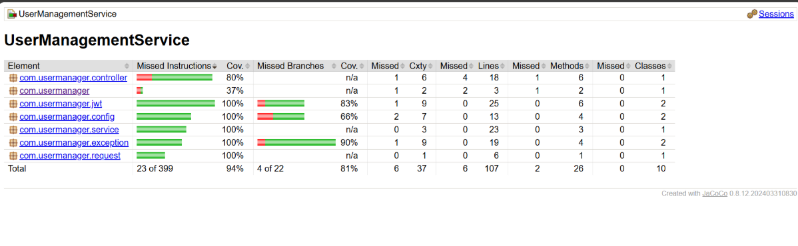

Slide 16
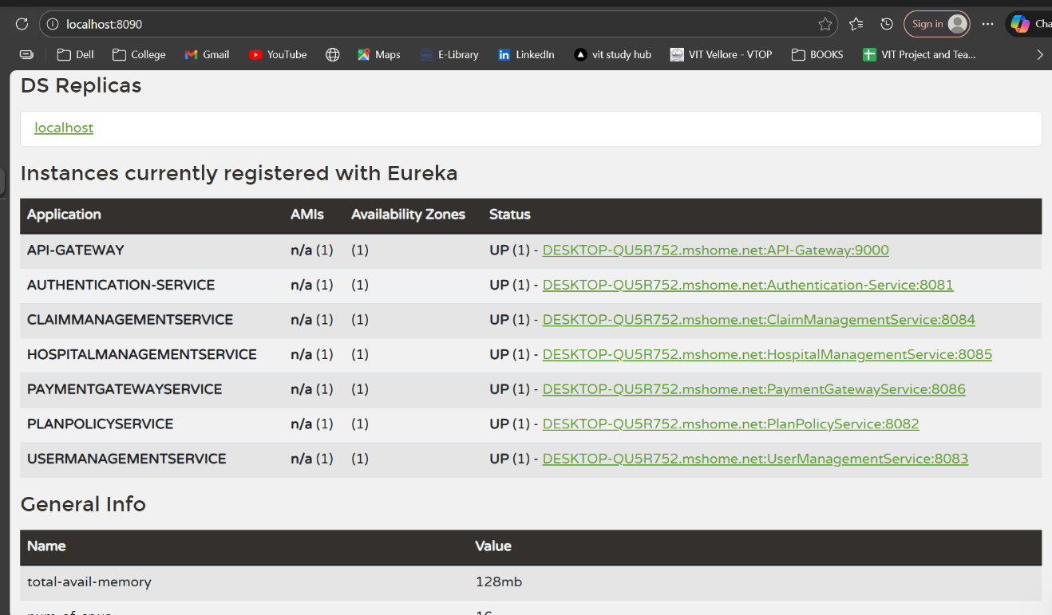
Microservices Architecture with Eureka Service Discovery

Slide 17

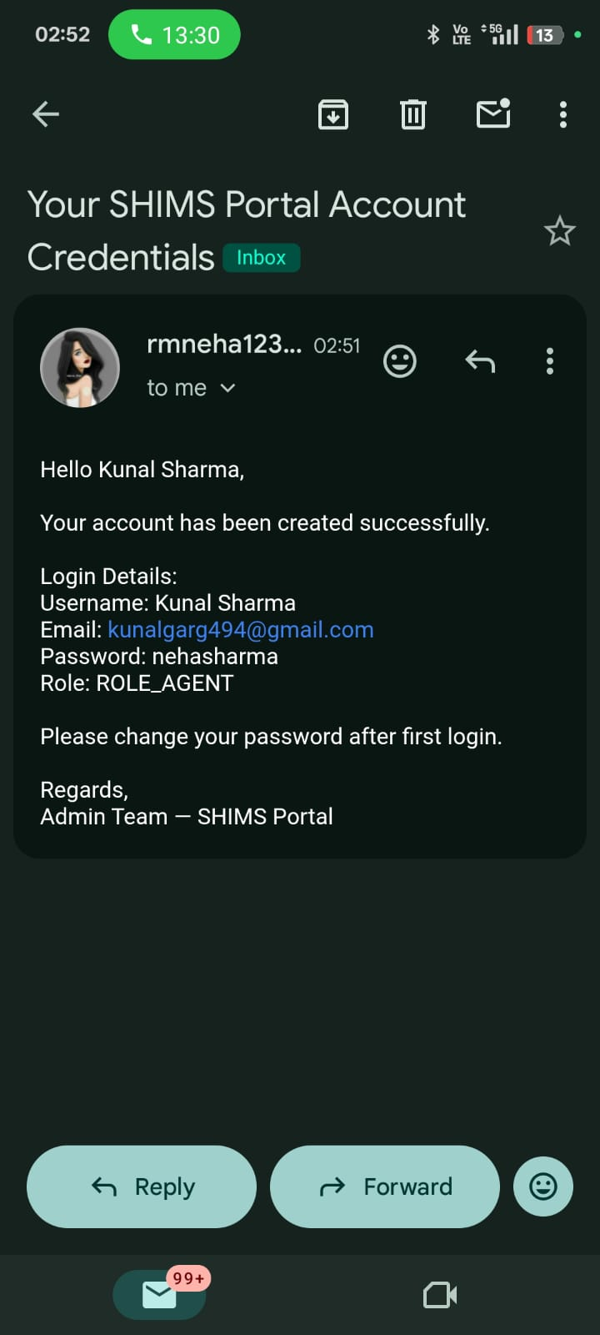
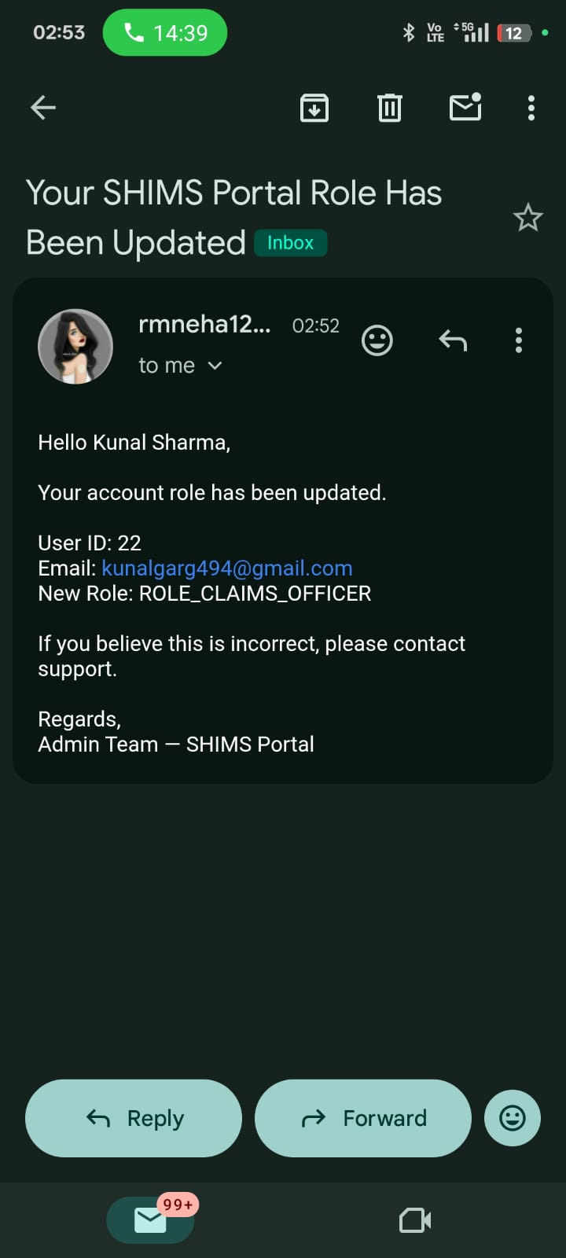
NOTIFICATIONS
SMTP Gmail Integration for Notifications
EMAIL NOTIFICATION FOR USER CREATION AND ROLE UPDATION:

Slide 18
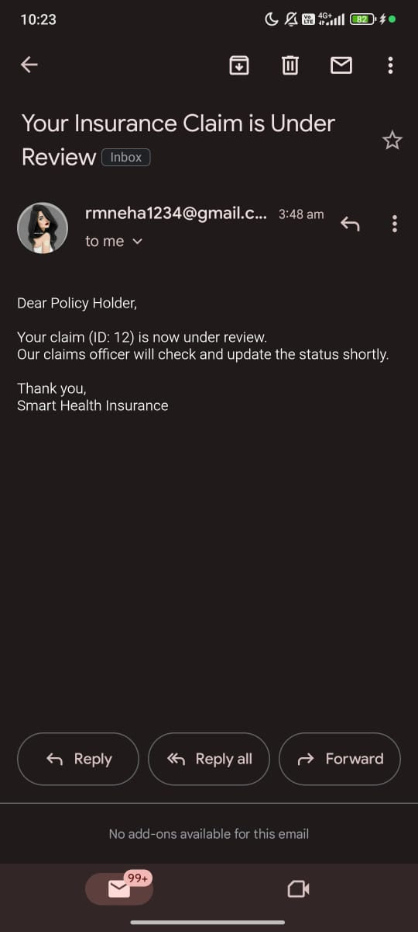
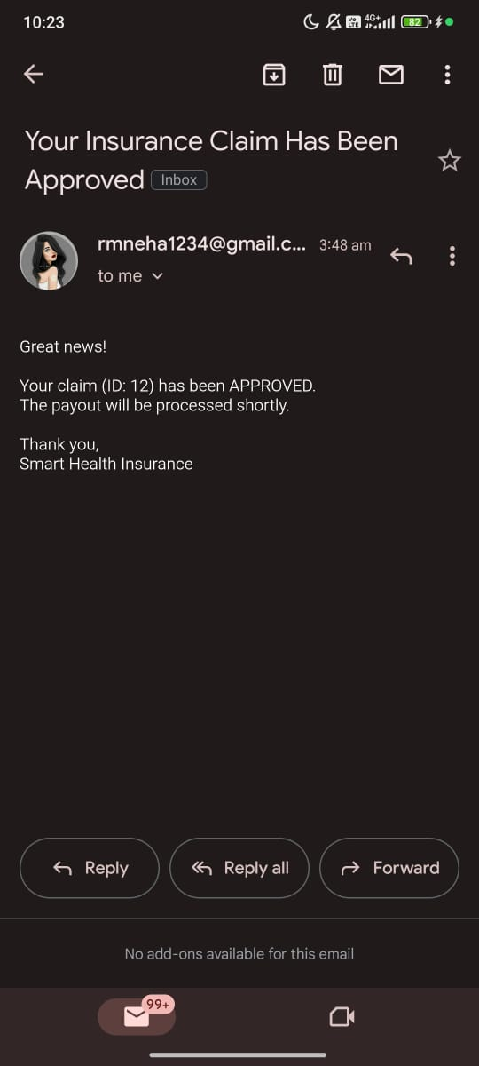
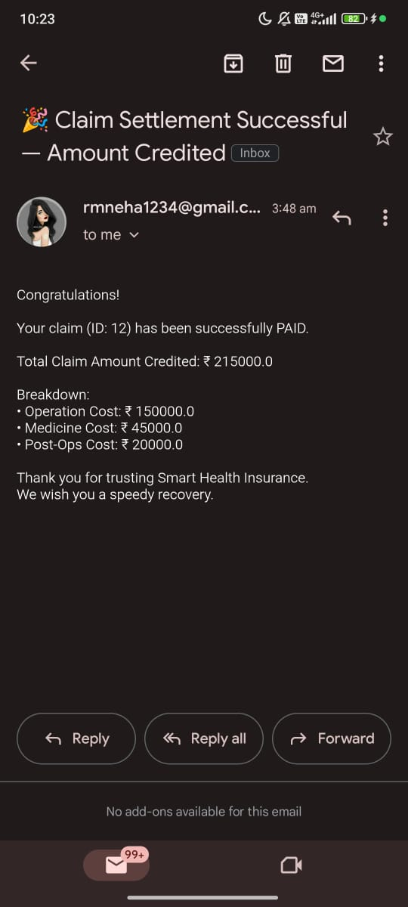
EMAIL NOTIFICATIONS FOR CLAIM PROCESSING AND STATUS UPDATE OF CLAIMS:

Slide 19
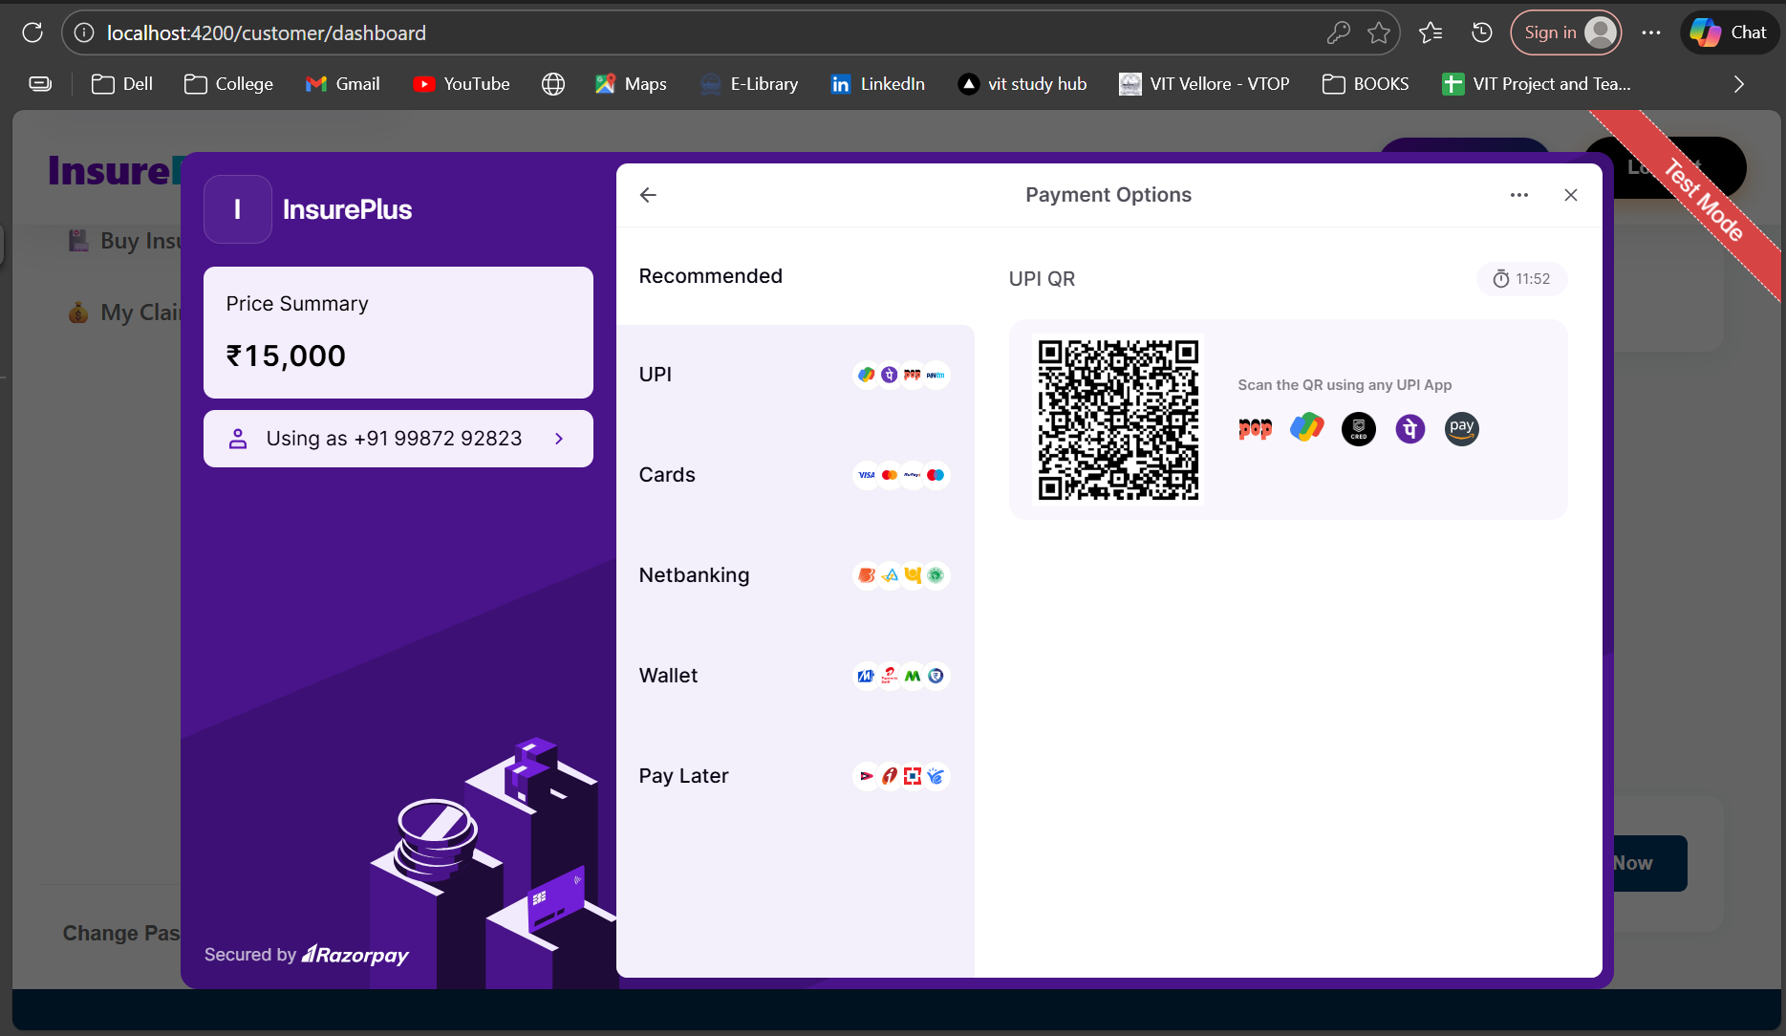
Payment Integration with Razorpay

Slide 20

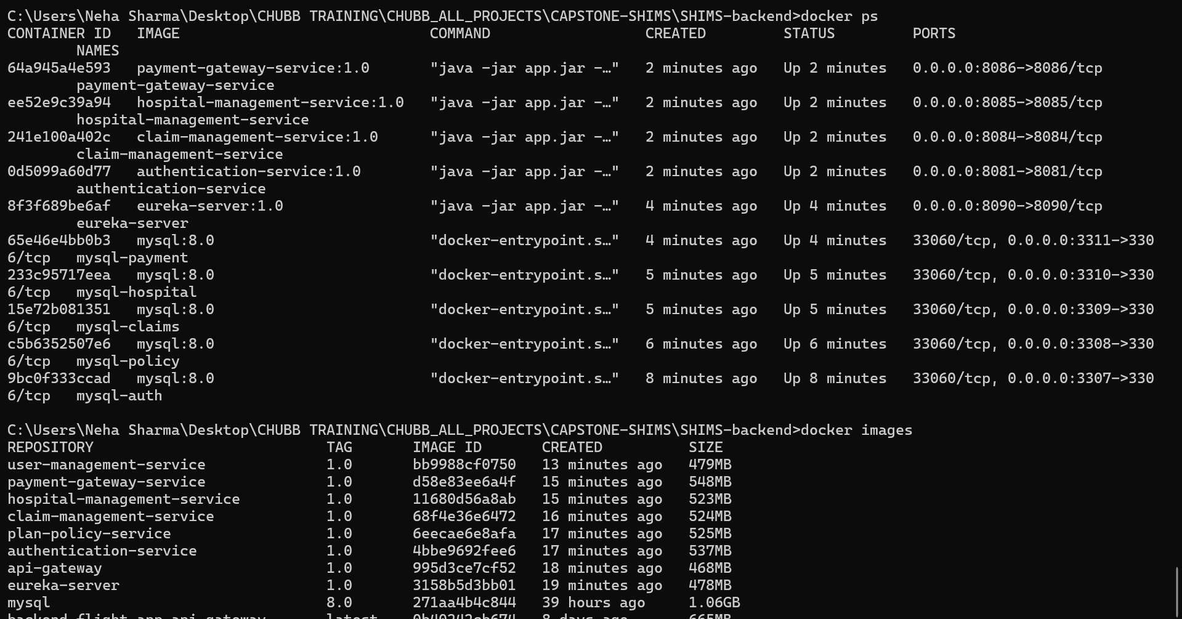
DEVOPS
Streamlined Operations: Docker Implementation

Slide 21
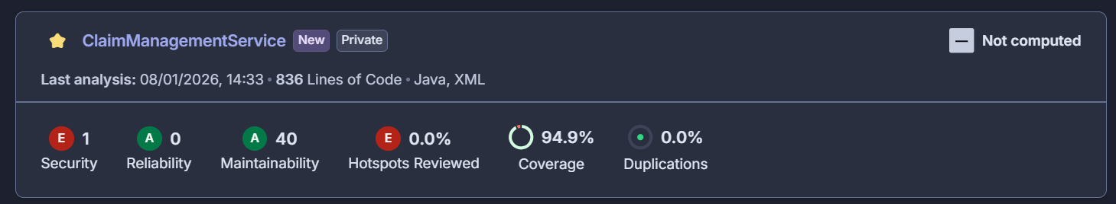
SonarQube: Continuous Code Quality Analysis
Static Code Analysis
SonarQube performs comprehensive static analysis, detecting bugs, code smells, and security vulnerabilities across all microservices. Detailed reports highlight technical debt and maintainability issues.
Quality Gates
Configurable quality gates enforce coding standards and coverage thresholds, preventing substandard code from reaching production. Integration with CI/CD pipelines ensures continuous quality monitoring throughout the development lifecycle.

Slide 22
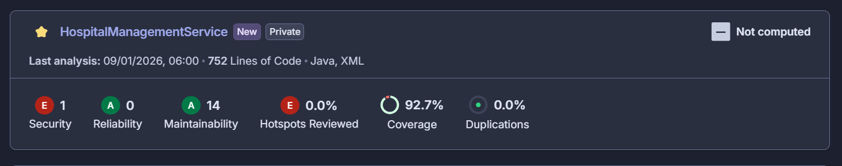
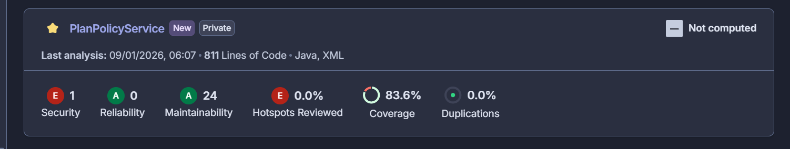
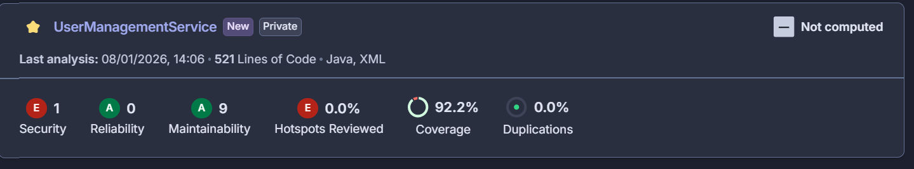

Slide 23
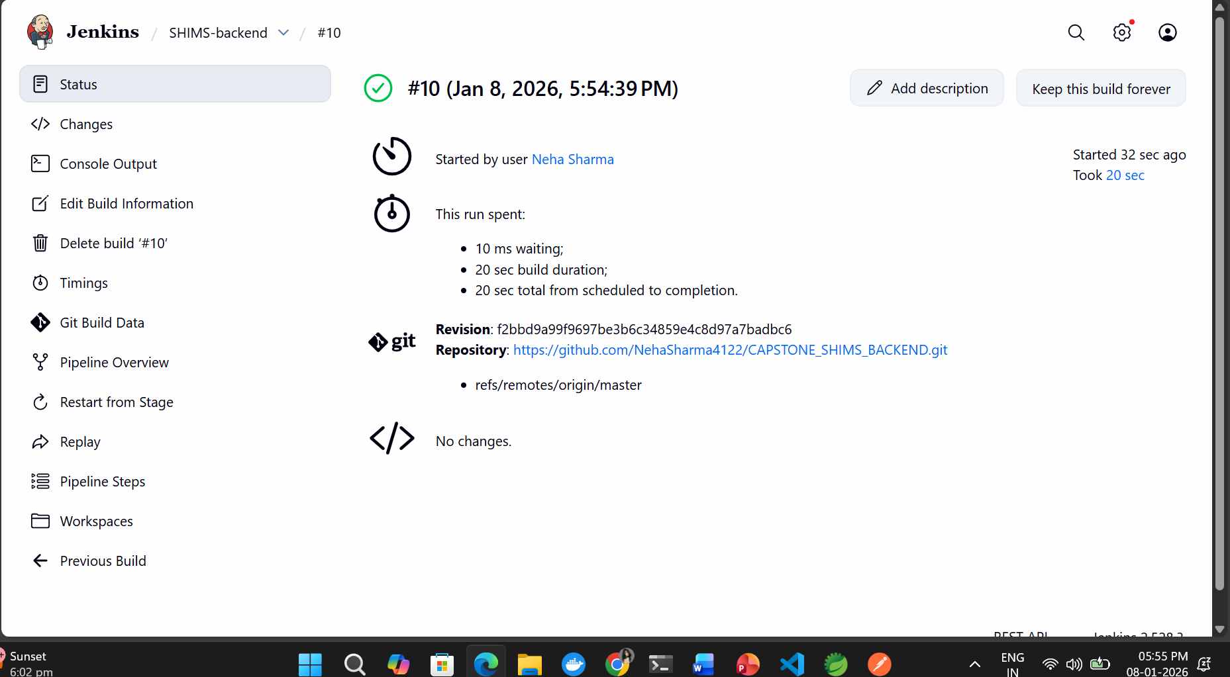
Jenkins: CI/CD Pipeline for Microservices

Slide 24
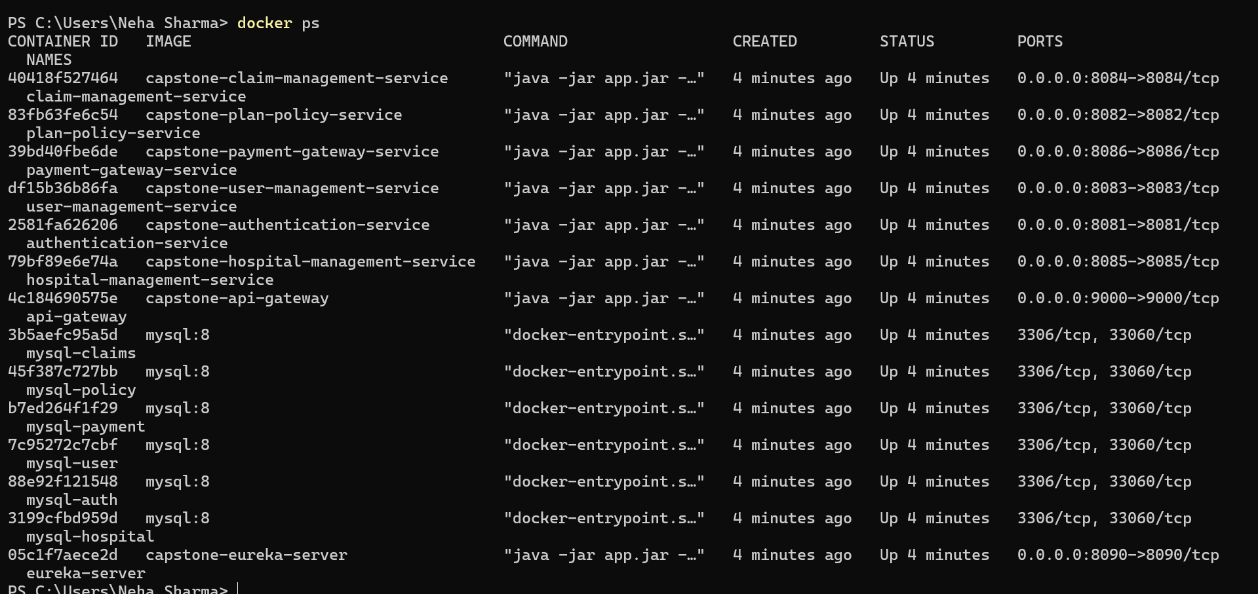

Slide 25
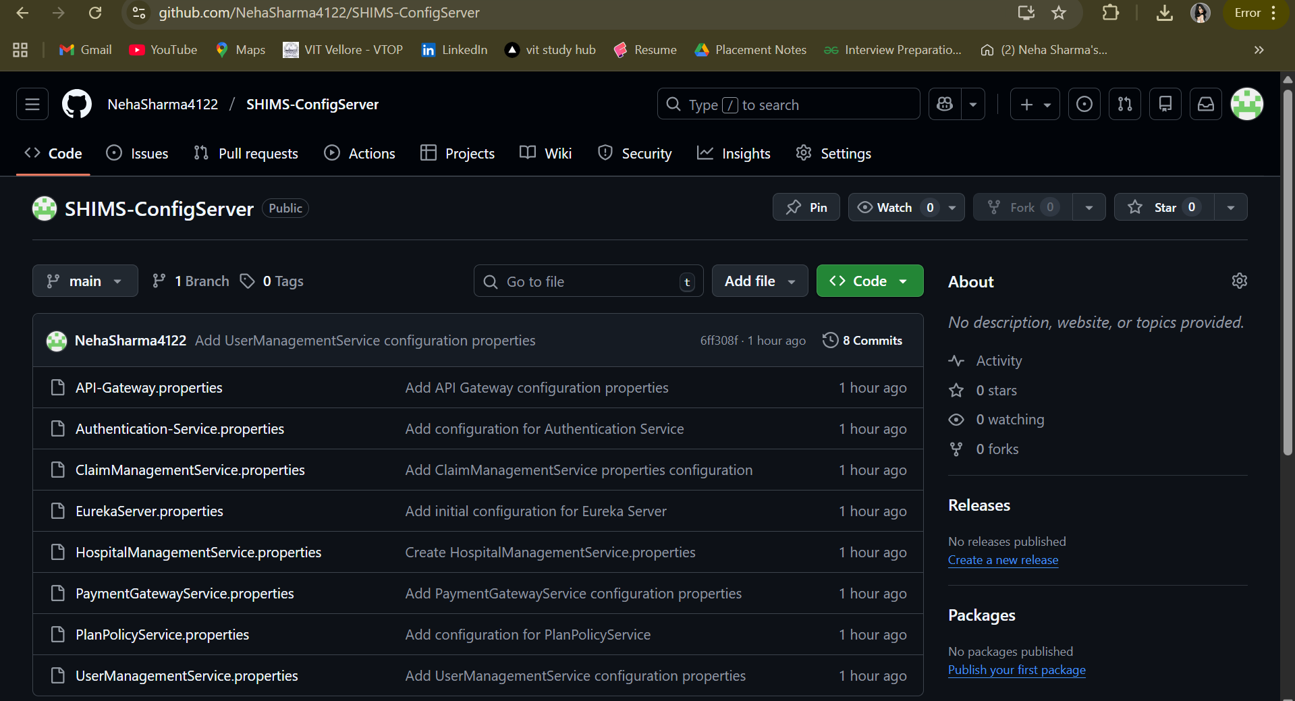
CONFIG SERVER

Slide 26

THANK YOU !

